Slide 1
Developing Apps for Touch and Mobile Devices

Slide 2
Objectives
In this session, you will learn to:
  Identify sensors
  Work with sensors
  Adjust sensor data

Slide 3

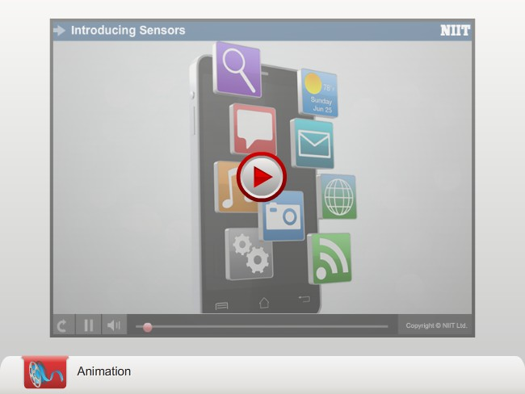
Types of Sensors

Slide 4
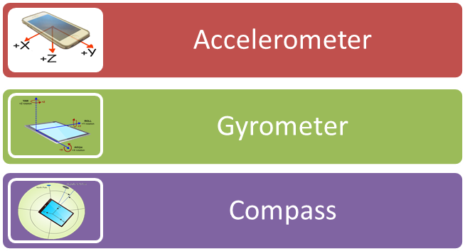
Types of Sensors (Contd.)
Sensors are hardware components embedded inside mobile devices.
These are capable of detecting the direction, orientation, and movement of your mobile device.
Sensors are of different types and each type has its own characteristics and is used for specific purposes.
Some of the popular sensors available in smartphones are:
As a developer, it is essential to know how different types of
sensors work and what type of output is generated by each
of them.

Slide 5
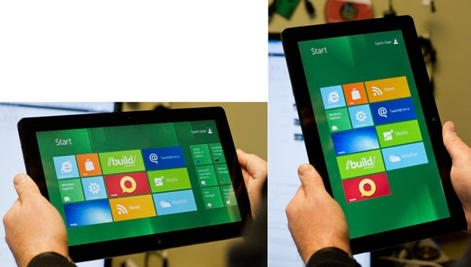
Types of Sensors (Contd.)
Accelerometer
An Accelerometer is an electronic device that detects force due to gravity on the X, Y, and Z axes of the device.
Most of the mobile devices have built-in accelerometers that determine the direction in which the device tilts and moves.
One of the popular implementations of accelerometers in mobile devices is the change of display from portrait to landscape, or vice versa, when the orientation of the device changes.
Portrait and Landscape Display of Devices

Slide 6
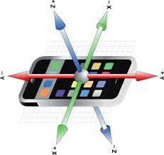
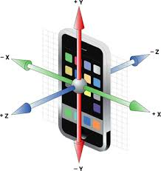
Types of Sensors (Contd.)
To determine the direction in which the device moves, the accelerometer measures the gravitational forces
(or G-force) applied to the device at a given point of time.
An accelerometer measures the acceleration due to gravity on the X, Y, and Z axes.
The acceleration values on different axes depend on the device’s orientation.
Horizontal Placement of Device
Perpendicular Placement of Device

Slide 7
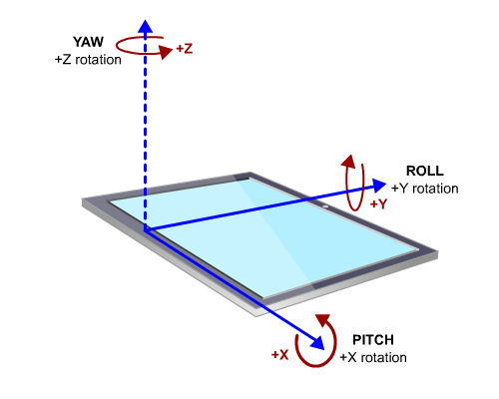
Types of Sensors (Contd.)
Gyrometer
A Gyrometer is also known as a Gyroscope.
Unlike accelerometer, that measures linear acceleration on the X, Y, and Z axes, gyrometer measures angular velocities around each axis.
These values for the X, Y, and Z axes are known as pitch, roll, and yaw.
Gyrometer provides more accurate information about the movement of the device than an accelerometer.
The gaming apps use gyrometer to detect devices’ up and down movements and rotation around each axis to provide more accuracy as compared to an accelerometer.
Pitch, Roll, and Yaw

Slide 8
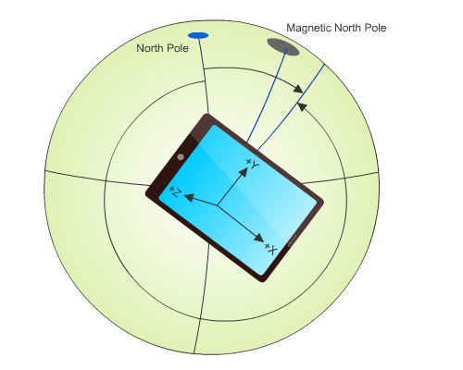
Types of Sensors (Contd.)
Compass
A Compass is also known as a Magnetometer.
It determines the angle through which a device is moving with respect to the Earth’s magnetic north pole or the true north pole in a two-dimensional plane.
True north pole is the actual north pole.
The magnetic north pole is some other location on the Earth’s surface, away from the true north pole.
Magnetic North Pole and True North Pole

Slide 9
Types of Sensors (Contd.)
Inclinometer
The inclinometer sensor determines yaw, pitch, and roll values.
It is mostly used to determine the device orientation in space due to the accuracy in its readings.
You can use an inclinometer in an app to change the device’s display based on the orientation of the device.

Slide 10
The Sensor Coordinate System
A system that uniquely identifies the position of a point using the point’s coordinates is known as a coordinate system.
This system consists of one or more axes, such as X, Y, and Z.
This system is also used by various sensors available in smartphone to detect the direction, orientation, and movement of smartphone.
The coordinate system that is used by various sensors of smartphone is known as a sensor coordinate system.
Similar to the coordinate system, the sensor coordinate system also consists of different axes.

Slide 11
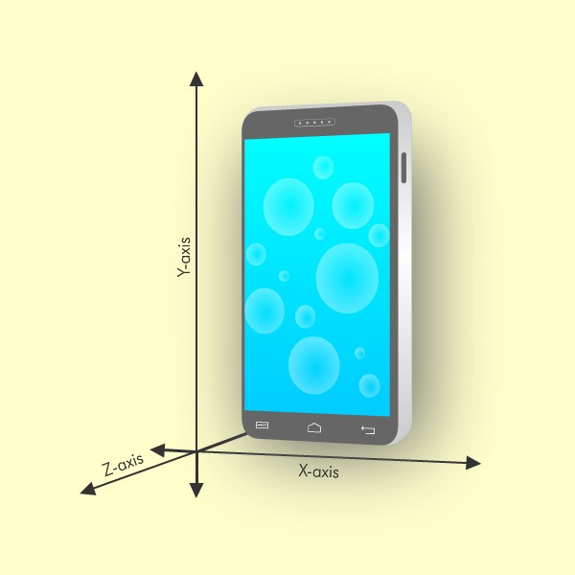
The Sensor Coordinate System (Contd.)
Identifying Axes of the Sensor Coordinate System
The sensor coordinate system in any mobile device consists of three axes, X, Y, and Z.
The positive X-axis is from left to right on the face of the device.
The positive Y-axis is from bottom to top on the face of the device.
The positive Z-axis is from back of the device to the front of the device out of the screen.
Sensor Coordinate System

Slide 12
The Sensor Coordinate System (Contd.)
Determining the Axes Values
You can hold and move mobile devices in any position you want.
When the position of a device changes, the reference axes of the device move along with the device, and the sensor output values also change accordingly.
It is essential to determine values on these axes due to change in the position of these devices.
Since the Earth’s gravity is always in the downwards direction towards the Earth’s surface, you can easily determine the axes values considering the following pieces of information:
  The axis that travels in the same direction of Earth’s gravity will have the value +1g.
  The axis that travels in the opposite direction of Earth’s gravity will have the value -1g.
  The axes that travel in other directions will have the value 0g.

Slide 13
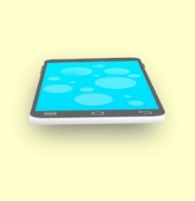
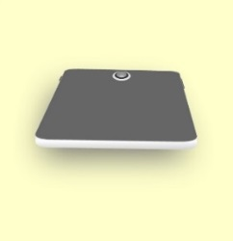
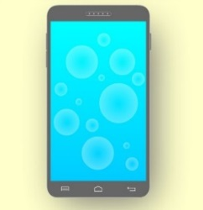
The Sensor Coordinate System (Contd.)
The following table shows the axes values of the sensor coordinate system due to change in the position of mobile devices.
Description About Position of Mobile Device | Reference Axes | Axes Values
Holding the mobile device as if placed on a table top with face up |  | X=0g Y=0g Z=-1g
Holding the mobile device as if placed on a table top with face down |  | X=0g Y=0g Z=+1g
Holding the mobile device as if hanging on a wall with no rotation |  | X=0g Y=-1g Z=0g

Slide 14
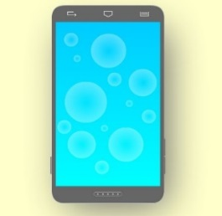
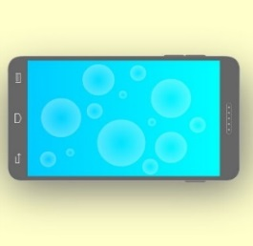
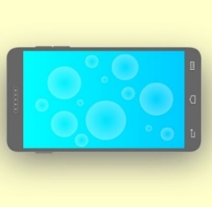
The Sensor Coordinate System (Contd.)
Description About Position of Mobile Device | Reference Axes | Axes Values
Holding the mobile device as if hanging on a wall flipped vertically (with 180 degrees of rotation) |  | X=0g Y=+1g Z=0g
Holding the mobile device as if hanging on a wall with 90 degrees of rotation clockwise |  | X=+1g Y=0g Z=0g
Holding the mobile device as if hanging on a wall with 90 degrees of rotation anticlockwise |  | X=-1g Y=0g Z=0g
Axes Values of the Sensor Coordinate System

Slide 15
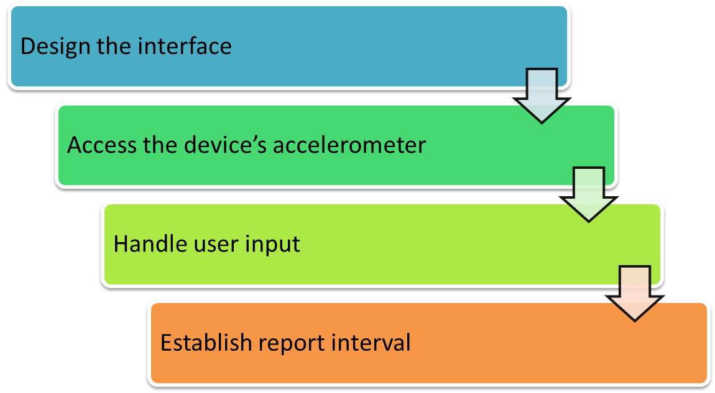
Reading Accelerometer Data
To develop an app that responds to user movement with the help of an accelerometer, you need to perform the following tasks:

Slide 16

Reading Accelerometer Data (Contd.)
Designing the interface:
  To develop an app, you first need to design the interface.
Accessing the device’s accelerometer:
  To access the accelerometer’s data, you need to establish a connection with the device’s accelerometer.
  The following code snippet shows how to access the default accelerometer in the onactivated() method in the default.js file:
  if(accelerometer == null){
  accelerometer = Windows.Devices.Sensors.Accelerometer.getDefault();}

Slide 17
Reading Accelerometer Data (Contd.)
Handling user input:
  To handle user input or movement, you need to associate an event listener to the accelerometer.
  If there is a change, the event listener will invoke a user-defined function associated with it and pass the changed reading to the user-defined function.
  This user-defined function will perform the required tasks to display the correct values.

Slide 18

Reading Accelerometer Data (Contd.)
The following code snippet shows the user-defined function associated with the event listener to display the accelerometer’s updated values to the users:
  function onReadingChanged(e)
  {
  var reading = e.reading;
  var accleX = reading.accelerationX;
  var accleY = reading.accelerationY;
  var accleZ = reading.accelerationZ;
  document.getElementById("X").value = accleX.toFixed(2);
  document.getElementById("Y").value = accleY.toFixed(2);
  document.getElementById("Z").value = accleZ.toFixed(2);
  }

Slide 19
Reading Accelerometer Data (Contd.)
Establishing report interval:
  Report interval is the duration after which the sensor delivers its readings.
  The default value of this interval depends on the sensor driver’s implementation.
  You can set the report interval in an app using the reportInterval property of the Accelerometer object.
  You can access the minimum report interval supported by the accelerometer of the device using the minimumReportInterval property of the Accelerometer class’s object.
  While setting the report interval in an app, ensure that the interval is set before:
    An event handler is registered with the Accelerometer object.
    The current readings are read from the accelerometer.
Mobile apps that use accelerometer’s data work with mobile devices that have an in-built accelerometer.

Slide 20
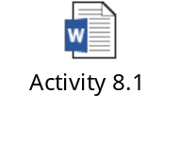
Activity 8.1: Reading Accelerometer Data
Problem Statement:
Solution:
To complete this activity, you need to perform the following steps:
  Design the interface of the app.
  Access the device’s accelerometer.
  Handle the user input.
  Establish report interval.
  Execute the app.

Slide 21
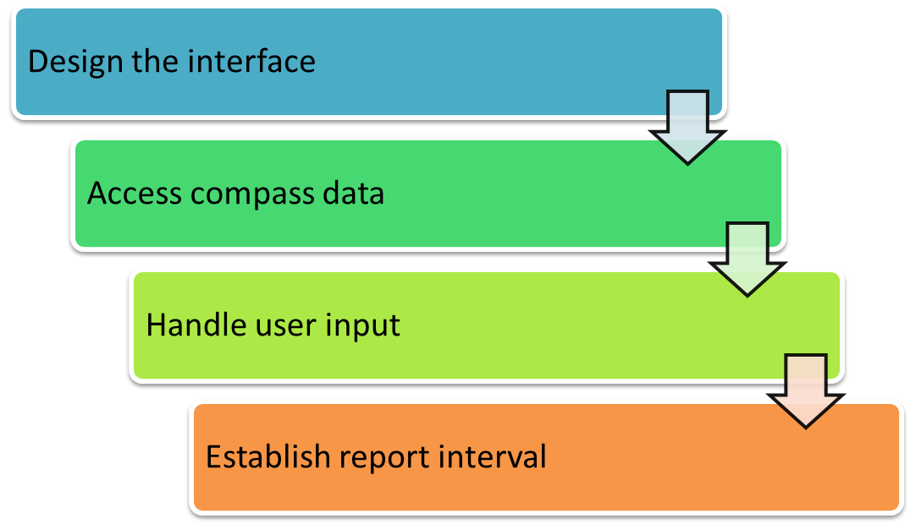
Reading Compass Data
To develop an app that determines the direction in which the device is pointing on user movement using a compass, you need to perform the following tasks:

Slide 22
Reading Compass Data (Contd.)
Designing the interface:
  You need to design the interface of the app in such a way that it determines the direction in which the device is pointing with respect to magnetic north and true north.
Accessing compass data:
  Establish a connection with the device’s compass to access its readings.
  Use the getDefault() method of the Compass class to establish such a connection.
  The getDefault() method returns the compass’s default values to the app.
Handling user input:
  To handle user movement, you need to associate an event listener with the compass to keep track of whether the compass’s reading is changed.
Establishing report interval:
  Report interval for the compass can be set in the same way as report
  interval for the accelerometer.

Slide 23
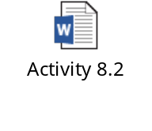
Activity 8.2: Reading Compass Data
Problem Statement:
Solution:
To complete this activity, you need to perform the following steps:
  Design the interface.
  Access the device’s compass.
  Handle the user input.
  Establish report interval.
  Display the compass value.
  Execute the app.

Slide 24
Distinguishing Between Display and Device Orientations
The direction of content available in the form of text and images on your
smartphone’s screen is known as display orientation.
While using your smartphone when you change its physical positioning, for example, from portrait to landscape or vice-versa, the display orientation changes.
It happens only if you have enabled the screen rotation or orientation of your smartphone.
The change in display orientation happens due to a change in the physical positioning of the smartphone.
The physical positioning of your smartphone is known as device orientation.

Slide 25
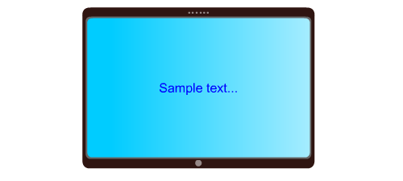
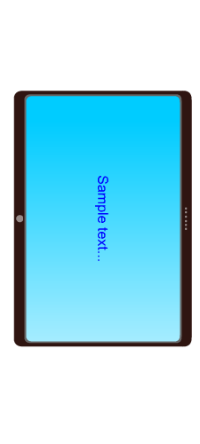
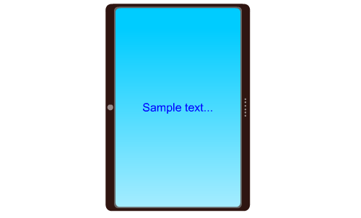
Distinguishing Between Display and Device Orientations (Contd.)
Display and Device Orientations for Landscape-First Devices
The landscape-first devices are the devices whose default orientation is landscape.
The following table shows the display orientations for various device orientations of landscape-first devices when screen rotation is disabled or enabled.
Device Orientation | Display Orientation With Screen Rotation Disabled | Display Orientation With Screen Rotation Enabled
Landscape
Portrait

Slide 26
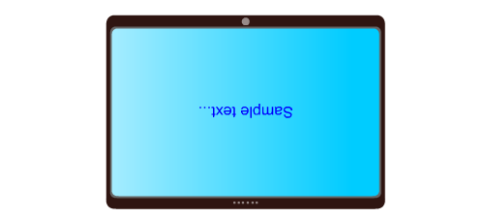
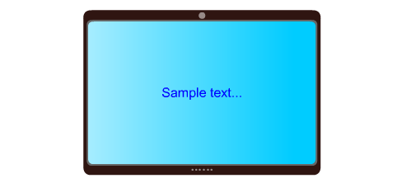
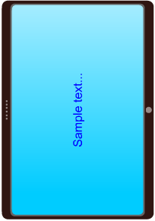
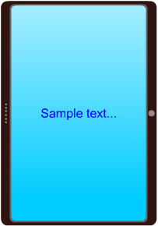
Distinguishing Between Display and Device Orientations (Contd.)
Device Orientation | Display Orientation With Screen Rotation Disabled | Display Orientation With Screen Rotation Enabled
LandscapeFlipped
PortraitFlipped
Display Orientations for Landscape-First Devices

Slide 27
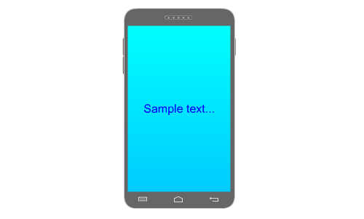
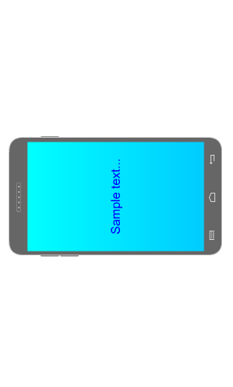
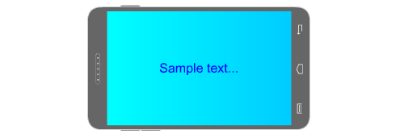
Distinguishing Between Display and Device Orientations (Contd.)
Display and Device Orientations for Portrait-First Devices
The portrait-first devices are the devices whose default orientation is portrait.
The following table shows the display orientations for various device orientations of portrait-first devices when screen rotation is disabled and enabled.
Device Orientation | Display Orientation With Screen Rotation Disabled | Display Orientation With Screen Rotation Enabled
Portrait
Landscape

Slide 28
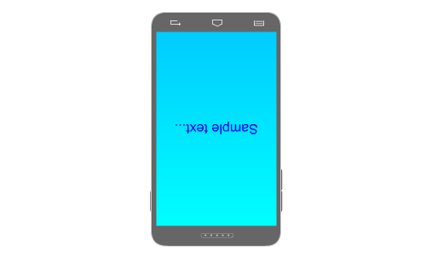
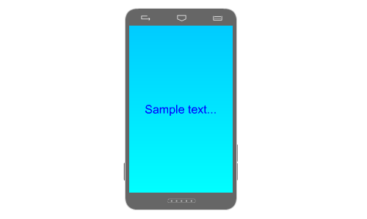
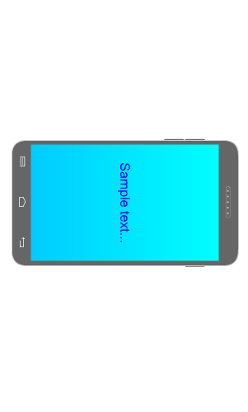
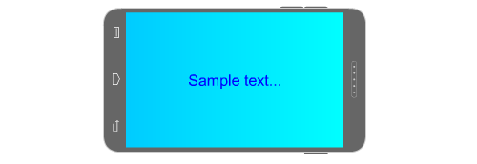
Distinguishing Between Display and Device Orientations (Contd.)
Device Orientation | Display Orientation With Screen Rotation Disabled | Display Orientation With Screen Rotation Enabled
PortraitFlipped
LandscapeFlipped
Display Orientations for Portrait-First Devices

Slide 29
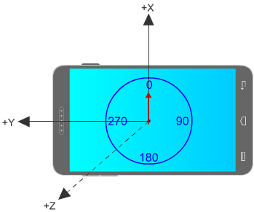
Need to Adjust Sensor Data
To know the direction in which you are heading, you use compass app that displays the direction information.
Compass in Landscape Orientation
In the figure, the compass reading is 0 degree, which indicates that the compass is pointing in the north direction.

Slide 30
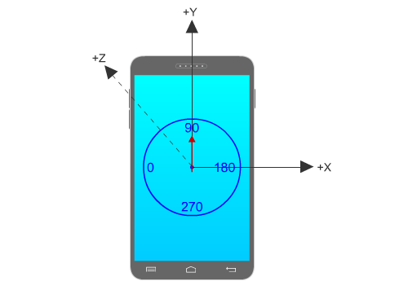
Need to Adjust Sensor Data (Contd.)
If you change the orientation of the device from landscape to portrait while facing the same direction, the reference system will also move.
As the device rotates, the reference system also rotates which results in inaccurate values on X, Y, and Z axes.
To find out accurate values, the reference system should remain fixed, which is impossible. Therefore, you need to adjust sensor data as per the orientation of the device.
Compass in Portrait Orientation

Slide 31
Determining Device Orientation
When you need to perform some action as the orientation of the device changes, you should know the current orientation of the device.
The process of determining the orientation of the device differs with different platforms.
You need to write different code snippets to determine the orientation of a device for Windows Phone, Android, or iOS.
You can determine the orientation values of Windows Phone devices by using the currentOrientation property of the value returned by the getForCurrentView() method of the DisplayInformation class.
  The DisplayInformation class monitors the information related to the physical display orientation of the device.
  The getForCurrentView()method contains the device’s current display-related information.
The DisplayOrientations enumeration describes the
orientation of the device.

Slide 32
Determining Device Orientation (Contd.)
The following table lists various members of the DisplayOrientations enumeration.
Member | Value | Description
none | 0 | Display orientation is unspecified.
landscape | 1 | Display orientation of the device is landscape.
portrait | 2 | Display orientation of the device is portrait, which means the device is rotated 90 degrees clockwise.
landscapeFlipped | 4 | Display orientation of the device is landscape but the device is rotated 180 degrees clockwise from the normal landscape mode.
portraitFlipped | 8 | Display orientation of the device is landscape but the device is rotated 180 degrees clockwise from the normal portrait mode or 90 degrees anticlockwise from the normal landscape mode.

Slide 33
Adjusting Sensor Data
Adjusting Accelerometer Axes
To make adjustments to the sensor data to reflect accurate values, you can adjust accelerometer and compass readings.
The adjustments are made in accelerometer data based on device orientation.
The getForCurrentView()method is used to retrieve the information related to the current physical orientation of the device.

Slide 34
Adjusting Sensor Data (Contd.)
Adjusting Compass Heading
You need to manipulate the compass heading based on device’s actual orientation.
The compass reading is manipulated using the formula,(heading + displayOffset) % 360 and stored in the variable, displayCompensatedHeading.
The following table shows compass reading according to the display orientation.
Display Orientation | Compass Reading When Facing North | Adjustment in Compass Reading
Landscape | 0 | Reading
Portrait | 90 | (Reading + 270)%360
LandscapeFlipped | 180 | (Reading + 180)%360
PortraitFlipped | 270 | (Reading + 90)%360
Adjusting Compass Heading

Slide 35
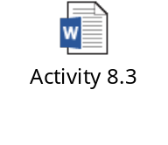
Activity 8.3: Adjusting Sensor Data
Problem Statement:
Solution:
To complete this activity, you need to perform the following steps:
  Adjust the compass reading for different orientations.
  Adjust the compass display on the UI.
  Execute the app.

Slide 36
Summary
In this session, I learned that:

